Slide 1
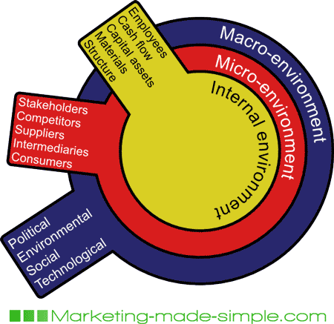
MARKETING ENVIRONMENT
The internal and external influences which affect marketing decision making and have an impact on its performance is called marketing environment
Organization must adapt continuously to the changing environment.

Slide 2
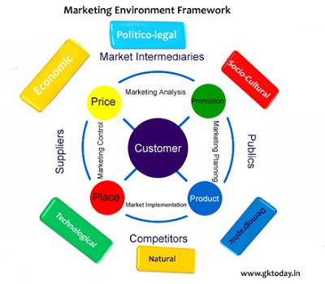

FRAMEWORK

Slide 3
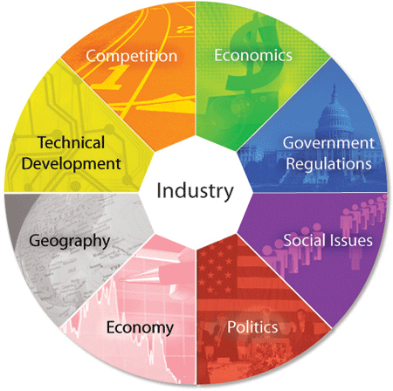
MACRO-ENVIRONMENT
Macro environment
Demographic
Economic
Natural
Technological environment
Political
Legal
Socio-cultural

Slide 4
Marketing Environment
The marketing environment includes six major forces:
Demographic
Economic
Competitive
Sociocultural
Political-legal
Technological
Marketers must pay attention to the interactions of these forces, as these will lead to new opportunities and threats

Slide 5


DEMOGRPHIC FACTORS
The environment concerned with the nature and characteristics of population under which the business operates.it consists of factors relating to population.
Size
Growth rate
Age distribution
Religious composition
Literacy levels
Various aspects like regional characteristics, household patterns

Slide 6
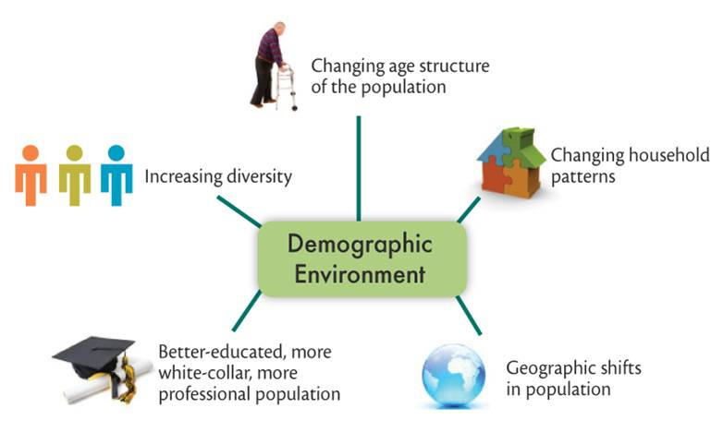
Demographic Environment
Factors relating to population such as size, growth rate, age distribution, religions, composition and literacy levels and aspects like composition of workforce, household, regional characteristics, population shifts etc need to be studied.

Slide 7
Demographic Environment
The size of population and its growth rate in urban, rural, state level, and nation is an important factor because people have needs and wants and constitute a market.
Demographic trends are highly reliable for the short and intermediate run.
The main demographic force that marketers monitor is population because people make up markets.
Marketers are keenly interested in the:
Size and growth rate of populations in cities, regions, and nations.
Age distribution and ethnic mix.
Educational levels.
Household patterns.
Regional characteristics and movements

Slide 8
Population and Demographics
Size
Growth rate
Age distribution
Ethnic mix
Educational levels
Household patterns
Regional characteristics
Movement

Slide 9
Demographic Environment
Worldwide Population Growth
The world’s population is showing explosive growth: It totaled 6.1 billion in 2000 and will exceed 7.9 billion by the year 2025.
The population explosion has been a source of major concern.
Explosive population growth has major implications for business.
A growing population does not mean growing markets unless these markets have sufficient purchasing power.
Population Age Mix
National populations vary in their age mix.
There is a global trend toward an aging population.
A population can be subdivided into six age groups:
Preschool
School-age children
Teens
Young adults age 25 to 40
Middle-aged adults age 40 to 65
Older adults ages 65 and up
For marketers, the most populous age groups shape the marketing environment.

Slide 10
Demographic Environment
Ethnic and Other Markets
Countries vary in ethnic and racial makeup.
Ethnic groups have certain specific wants and buying habits.
Marketers must be careful not to overgeneralize about ethnic groups.
Within each ethnic group are consumers who are quite different from each other.
Diversity goes beyond ethnic and racial markets.
Educational Groups
The population in any society falls into five educational groups:
Illiterates.
High school dropouts.
High school degrees.
College degrees.
Professional degrees

Slide 11
Demographic Environment
Household Patterns
The “traditional household” consists of a husband, wife, and children (sometimes grandparents).
In the United States today, one out of eight households is "diverse” or “nontraditional” and includes:
Single live-alones.
Adult live-togethers of one or both sexes.
Single-parent families.
Childless married couples.
Empty-nesters.
Each group has a distinctive set of needs and buying habits
Marketers must increasingly consider the special needs of nontraditional households, because they are now growing more rapidly than traditional households

Slide 12
Demographic Environment
Geographical Shifts in Population
This is a period of great migratory movements between and within countries. Forward-looking companies and entrepreneurs are taking advantage of the growth in immigrant populations and marketing wares specifically to these new members of the population.
Within countries, population movement occurs as people migrate from rural to urban areas, and then to suburban areas.
Location makes a difference in goods and service preferences.
There are also regional differences.
Suburban growth and a disdain for commuting has helped those business that cater to the growing SOHO (small office-home office) segment.
Marketers also look at where consumers are flocking.

Slide 13

ECONOMICAL FACTORS
Economic conditions play a very significant role in the marketing system.
Determines the strength and size of the market
Marketing plans and programs are also influenced by many economic factors such as interest rates ,money supply, price levels ,savings etc.
Exchange fluctuations ,currency devaluation, changes in political and legal set-up influence international marketing.

Slide 14

Economic Environment
Economic environment determines the strength and size of the market. The purchasing power in an economy depends on income, price, savings, circulation of money, debt and credit availability.
Inflation is a major factor that affects the consumers behavior in the market.
In an inflationary environment, consumers become choosy, bargain for better deals, buy bulk. However, the very poor and very rich are not significantly impacted by temporary changes in the economy

Slide 15
Economic Environment
The size of market only in terms of population is not enough. It is the people with buying power that really constitute a meaningful market.
The general economic pattern is often described in four types of business cycles.
Prosperity
Recession
Depression
Recovery
Markets require purchasing power as well as people.
The available purchasing power in an economy depends upon:
Current income.
Prices.
Savings.
Debt.
Credit availability.
Marketers must pay careful attention to trends affecting purchasing power because they can have a strong impact on business, especially for companies whose products are geared to high-income and price-sensitive consumers

Slide 16
Economic Environment
Income Distribution
Marketers often distinguish countries with five different income-distribution patterns:
Very low incomes.
Mostly low incomes.
Very low, very high incomes.
Low, medium, high incomes.
Mostly medium incomes.
Over the past three decades in the United States, the rich have grown richer, the middle class has shrunk, and the poor have remained poor.
Consumer psychology :Savings, Debt, and Credit Availability
Consumer expenditures are affected by:
Savings.
Debt.
Credit availability.

Slide 17
Natural Environment
The deterioration of the environment is a major global concern.
In many world cities, air and water pollution have reached dangerous levels.
There is great concern about “greenhouse gases.”
New regulations have hit certain industries very hard.
Consumers often appear conflicted about the natural environment.
Marketers need to be aware of the threats and opportunities associated with four trends in the natural environment:
Shortage of raw materials, especially, water.
Increased cost of energy.
Increased pollution levels.
Changing role of governments.

Slide 18

NATURAL FACTORS
Environmental experts are advocating Preservation and survival of our entire ecological systems
Economical use of energy and natural resources must be essential ingredients of marketing strategies
In future marketing executives have to pass due attention to the quality of our life our environment
They must show active interest in welfare of community life.
Ecology or natural factors has assumed its importance under societal marketing concept since 1965

Slide 19

CONT…..

Slide 20

TECHNOLOGICAL FACTORS
Phenomenal development of technology has completely transformed the life and living conditions in developed and developing countries
New technologies are a main source of economic growth
Opportunities are arising out of technological innovation
Technology has literally transformed the way people think ,work and relax. It has the way people communicate with the advent o f internet and telecommunication
Examples :-a. electronic industry is the best example of exploiting new industries
b. television has adversely affected radio and cinema industries
Marketing management with the help of technology can create and deliver standards and styles of life in many countries.

Slide 21
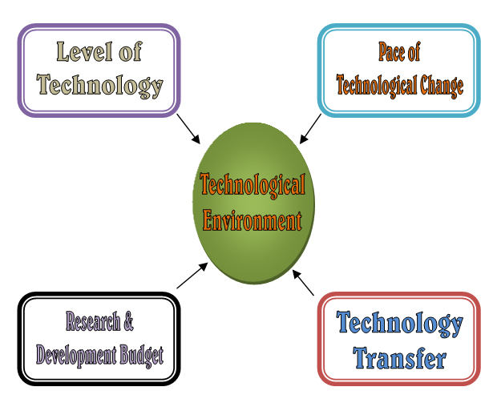
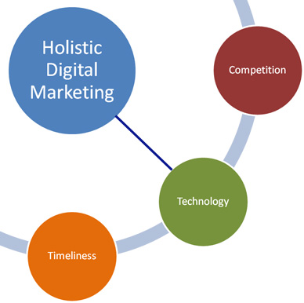
CONT…..

Slide 22

THE TECHNOLOGICAL ENVIRONMENT
The most important factor, which is controlling and changing the human society and even impacting the future, is technology.
Technology has literally transformed the way people think, work and relax.
Technology has changed the way people communicate with the advent of Internet and telecommunication system, and with the revolution in communications have come new ways of doing business.
The following factors are to be considered for the technological environment
The pull of technological change
Opportunities arising out of technological innovation
Risk and uncertainty of technological development

Slide 23
Technological Environment
One of the most dramatic forces shaping peoples’ lives is technology.
Every new technology is a force for “creative destruction.”
The economy’s growth rate is affected by how many major new technologies are discovered.
New technologies also creates major long-run consequences that are not always foreseeable.
Technology refers to the application of knowledge and tools to solve problems and achieve more efficiency.The marketer should monitor the following trends in technology:
Pace of change.
Opportunities for innovation.
Varying R&D budgets.
Increased regulation.

Slide 24


POLITICAL AND LEGALFACTORS
These factors are gaining importance in marketing activities
Firms prefer to operate in a country where there is sound political and legal system
Marketing system is affected by government monetary and fiscal policy, import and export policies and custom duties.
Legislation controlling physical environment e.g. anti-pollution laws also influence marketing plans and policies.
Consumer legislation tries to protect consumer interests from unfair trade practices.
Marketing management cannot ignore the legislation regulating competition and protecting consumers
Marketing policy making is influenced by government policies and controls throughout the world

Slide 25
Political and Legal Environment
The current laws, government agencies, and pressure groups put limits on marketing decisions and strategies of companies. Industries and organisations almost always maintain good relations with political officials to minimise the possibility of enacting unfavourable laws and regulations.
Marketing decisions are strongly affected by developments in the political and legal environment. This environment is composed of laws, government agencies, and pressure groups.
Sometimes these laws also create new business opportunities.
Two major trends are –
the increase in business legislation
the growth of special interest groups.

Slide 26
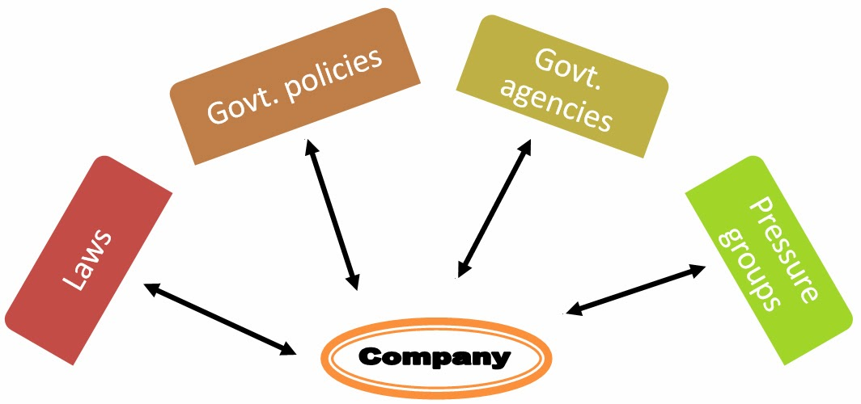
THE POLITICAL ENVIRONMENT
Political pressure groups influence and limit organizations.
Special interest groups and political action committees put pressure on business organizations to pay more attention to consumer's rights, minority rights, and women’s rights.
These laws create new business opportuinity.

Slide 27
POLITICAL FACTORS
The political environment of a country also affects the marketing of the firm since the political ideology shapes the policies of the country.
Political changes and changes in the style of functioning of the government affect the firms performance

Slide 28
THE LEGAL ENVIRONMENT
Firms prefer to operate in a country where there is a sound legal system such as in US.
Marketers must have a good working knowledge of the major laws protecting consumers competitions and organizations.
Laws like MRTP, Consumer Protection Act, Intellectual Property Right, FEMA, Labour Laws etc., can considerably affect business operations

Slide 29
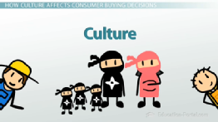
SOCIO-CULTURAL FACTORS
Socio-cultural factors or forces influence the welfare of the business concern in the long run.
Culture refers to the set of beliefs ,values and attitudes shared by contemporaries and passed on from generation to generation.
Social environment refers to the interaction of various members of the firm with the society

Slide 30
SOCIO-CULTURAL FACTORS
Socio-cultural factors or forces influence the welfare of the business concern in the long run.
Culture refers to the set of beliefs ,values and attitudes shared by contemporaries and passed on from generation to generation.
Social environment refers to the interaction of various members of the firm with the society

Slide 31
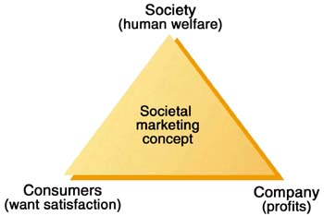
CONT….
Societal marketing concept demanding not only consumer welfare but also citizen welfare ,is due to the prevalent social environment and social or cultural values in advanced countries
Marketers are now looked upon not only to deliver high material standard of living but at the same time also assure quality of life.

Slide 32
CONT…
The three aspects of social environment :-
Change in our lifestyle and social values
e.g. Changing role of women, emphasis on quality of goods instead of quantity of goods.
Major social problems
e.g. concern for pollution of our environment socially responsible marketing policies need for safety in occupation and products
Growing consumerism indicating consumer dissatisfaction since 1960. consumerism is becoming increasingly in marketing decision making process

Slide 33
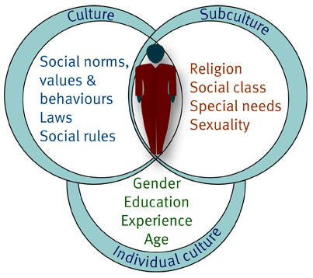
CONT….
The cultural factors include
Culture
Sub- culture

Slide 34


WHEAT PEOPLE VERSUS RICE PEOPLE
The main reason behind this article is to make people understand and give a clear picture about how grains define culture.
Rice people and wheat people are different. The different needs of the crops have led to sustained differences in the cultures of the people who have grown them. And then the contention is put forward that this has a lesson for modern politics.

Slide 35

Cultural Environment
The beliefs, values and norms of a society determine how individual and organizations relate to each other.
Marketers have a very little chance of changing the core values but hold a chance of changing secondary values.

Slide 36
Social-Cultural environment
Purchasing power is directed toward certain goods and services and away from others according to people’s tastes and preferences.
Society shapes the beliefs, values, and norms that largely define these tastes and preferences.
People absorb a worldview that defines their relationships to themselves, others, organizations, society, nature, and to the universe.
Every trend seems to breed a countertrend.
Here are some other cultural characteristics of interest to marketers:
The persistence of core cultural values.
The existence of subcultures.
Shifts of values through time.
High Persistence of Core Cultural Values
The people living in a particular society hold many core beliefs and values that tend to persist.
Core beliefs and values are passed on from parents to children and are reinforced by major social institutions.
Secondary beliefs and values are more open to change.
Marketers have some chance of changing secondary values but little chance of changing core values.

Slide 37
Social-Cultural Environment
Culture influences consumers through the norms and values established by the society in which they live.
Shifts of Secondary Cultural Values Through Time
Although core values are fairly persistent, cultural swings take place.
Existence of Subcultures
Each society contains subcultures, groups with shared values emerging from their special life experiences or circumstances.
Members of subcultures share common beliefs, preferences, and behaviors.
To the extent that subcultural groups exhibit different wants and consumption behavior, marketers can choose particular subcultures as target markets.
Marketers sometimes reap unexpected rewards in targeting subcultures

Slide 38
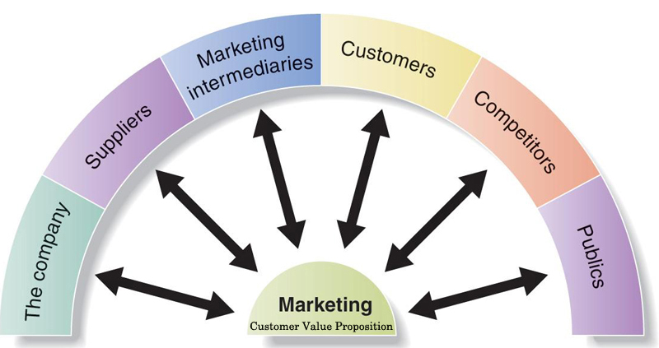

MICRO ENVIRONMENT
Micro environment
Organization
Corporate resources
Marketing mix
Markets
Supplies
Market intermediaries
Employees

Slide 39
MARKETING MIX
It refers to a set of variables or key inputs which are necessary for the marketing of the firm
They include four P’s ,namely product, price, place and promotion
In a service industry ,there are additional three P’s namely
Physical evidence
Process
People

Slide 40
Scanning and Analysing Environment
Environmental scanning
Environmental analysis
Demographic
Economic
Competitive
Company's
Marketing
Efforts
Sociocultural
Political-legal
Technological
Natural
Marketing Environmental Factors

Slide 41
Discussion Topic
MARKETING TODAY
“Green Marketing” has been a challenge to firms producing environmentally friendly products. The obstacles stated range from overexposure and lack of credibility, to the consumer not willing to pay a premium prices for “green” products, to poor implementation on the part of companies engaged in the practice.
Question: When faced with a decision to market its products as “environmentally safe” or to market its products along conventional lines (matching competitive positioning), does the company have a responsibility to choose the more socially responsible manner or should the dictates of the marketplace (i.e. consumer) decide its marketing strategy?

Slide 42
Competitive Environment
Competition in business terminology generally refers to the availability of other products and services by different marketers that are similar to or can be substituted for a particular company’s products or services in the same market.
Four general types of competitive structures include monopoly, oligopoly, monopolistic competition, and pure competition.

